Slide 1

6th Grade Math
Unit 2, Lesson 8 Dividing Positive Fractions Volume 1, pg. 81

Slide 2


Benchmark
MA.6.NSO.2.2
Extend previous understanding of multiplication and division to compute products and quotients of positive fractions by positive fractions with procedural fluency.
volume 1, pg. 81

Slide 3
Integrated Mathematical Thinking and Reasoning Standards
MA.K12.MTR.2.1 Demonstrate understanding by representing problems in multiple ways.
MA.K12.MTR.3.1 Complete tasks with mathematical fluency.
volume 1, pg. 81

Slide 4

Learning Target
I can fluently divide positive fractions by positive fractions.
volume 1, pg. 81

Slide 5

Warm-Up
volume 1, pg. 82

Slide 6
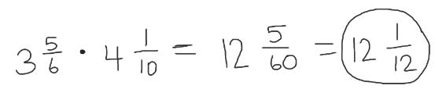

2.8.1 Warm-Up: Error Analysis
Mateo tried to multiply $3\frac{5}{6} ∙ 4\frac{1}{10}$, but he made an error. His work is shown.
What error did Mateo make?
What is something that Mateo did correctly?
volume 1, pg. 82

Slide 7

Help Mateo understand and learn from his mistake. Write a brief note to Mateo explaining the mistake he made and how to fix it moving forward.
Find the product of $3\frac{5}{6} ∙ 4\frac{1}{10}$. Show your work.
Means
I
Start
To
Acquire
Knowledge
Experience
Skills
volume 1, pg. 82

Slide 8

Guided Instruction
volume 1, pg. 82

Slide 9
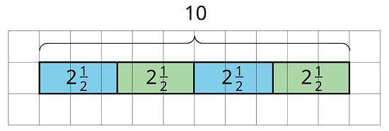
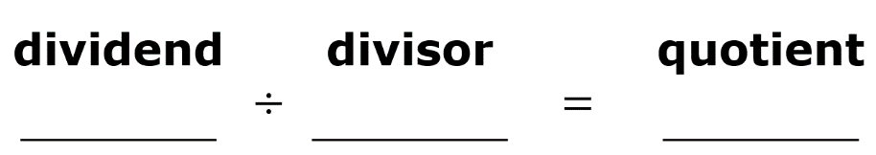

2.8.2 Guided Instruction: Dividing Fractions
Recall how tape diagrams can be used to illustrate division.
Write the division equation represented by the tape diagram.
How many groups of $2\frac{1}{2}$ are in $10$?
volume 1, pg. 82

Slide 10
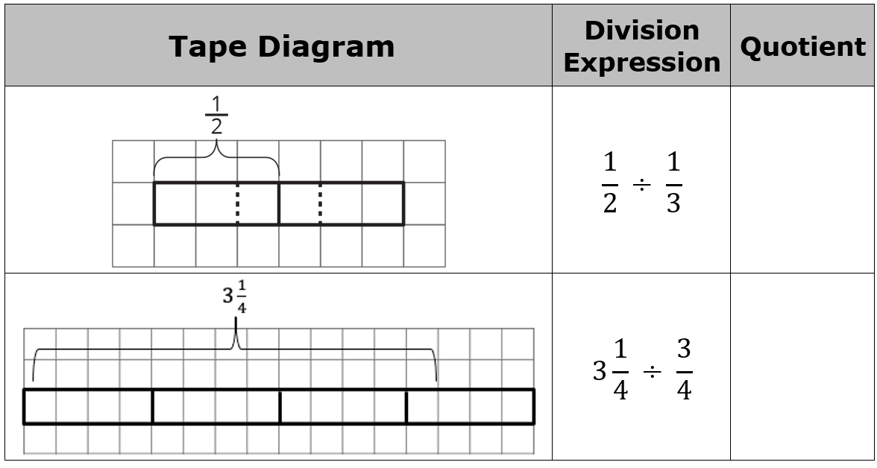
Complete the table by finding each quotient. Use the tape diagram shown.
volume 1, pg. 83

Slide 11
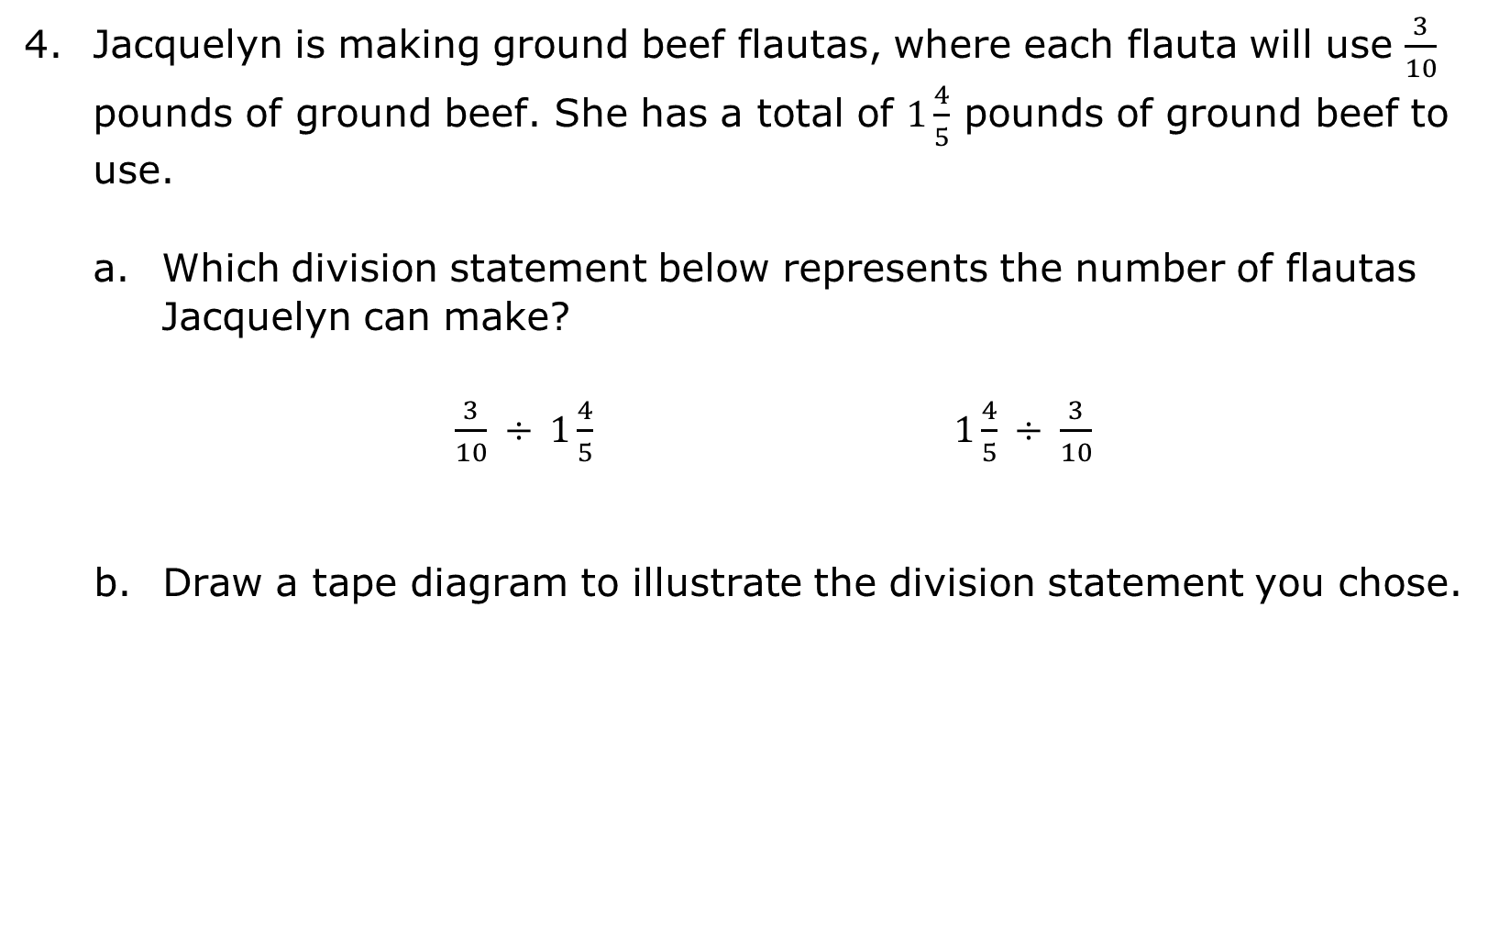
Jacquelyn is making ground beef flautas, where each flauta will use $\frac{3}{10}$ pounds of ground beef. She has a total of $1\frac{4}{5}$ pounds of ground beef to use.
Which division statement below represents the number of flautas Jacquelyn can make?
$\frac{3}{10} ÷ 1\frac{4}{5}$ $1\frac{4}{5} ÷ \frac{3}{10}$
Draw a tape diagram to illustrate the division statement you chose.
volume 1, pg. 83

Slide 12

Solve the division statement.
How many $\frac{3}{10}$ pound flautas can she make?
volume 1, pg. 83

Slide 13


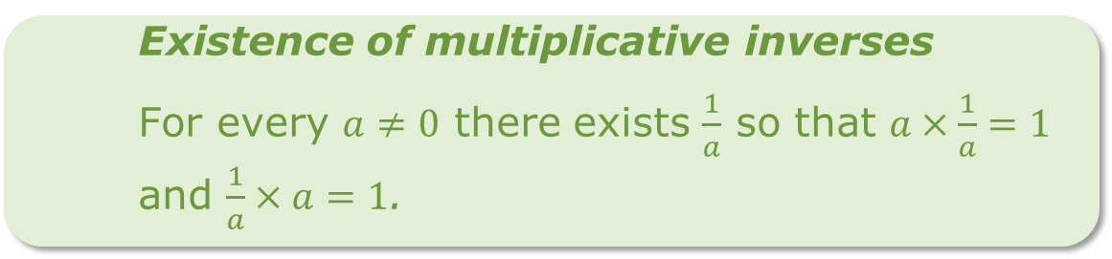
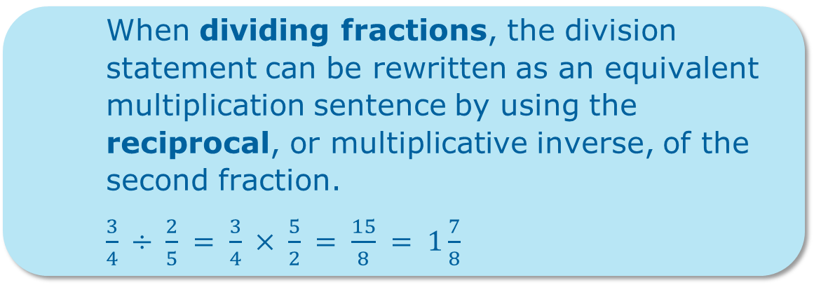
You previously developed an algorithm to use when dividing fractions.
When dividing fractions, the division statement can be rewritten as an equivalent multiplication sentence by using the reciprocal, or multiplicative inverse, of the second fraction.
$\frac{3}{4} ÷ \frac{2}{5} = \frac{3}{4} × \frac{5}{2} = \frac{15}{8} = 1\frac{7}{8}$
Existence of multiplicative inverses
For every $a≠0$ there exists $\frac{1}{a}$ so that $a×\frac{1}{a}=1$ and $\frac{1}{a}×a=1$.
volume 1, pg. 84

Slide 14
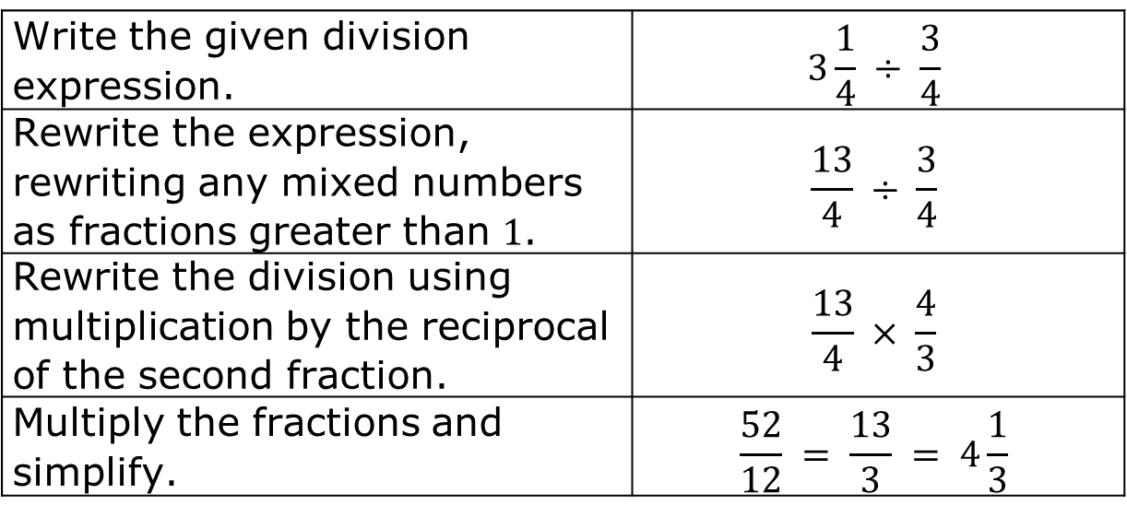

With the tape diagrams, you determined $3\frac{1}{4} ÷ \frac{3}{4} = 4\frac{1}{3}$.
The standard algorithm can also be used to determine the quotient.
Find the quotient $5\frac{2}{3} ÷ 2\frac{4}{9}$ using the algorithm.
Write the given division expression. | $$3\frac{1}{4} ÷ \frac{3}{4}$$
Rewrite the expression, rewriting any mixed numbers as fractions greater than $1$. | $$\frac{13}{4} ÷ \frac{3}{4}$$
Rewrite the division using multiplication by the reciprocal of the second fraction. | $$\frac{13}{4} × \frac{4}{3}$$
Multiply the fractions and simplify. | $$\frac{52}{12} = \frac{13}{3} = 4\frac{1}{3}$$
volume 1, pg. 84

Slide 15

Guided Practice
volume 1, pg. 85

Slide 16

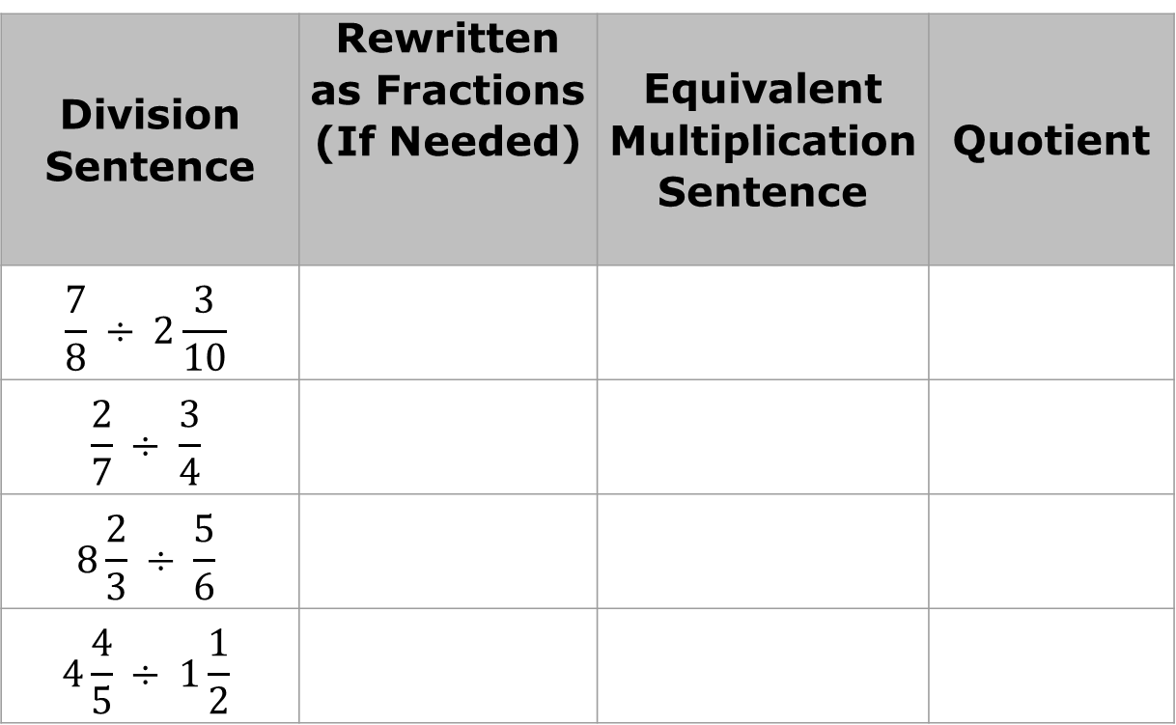
2.8.3 Guided Practice: Dividing Fractions
Complete the table to find each quotient.
Division Sentence | Rewritten as Fractions (If Needed) | Equivalent Multiplication Sentence | Quotient
$$\frac{7}{8} ÷ 2\frac{3}{10}$$
$$\frac{2}{7} ÷ \frac{3}{4}$$
$$8\frac{2}{3} ÷ \frac{5}{6}$$
$$4\frac{4}{5} ÷ 1\frac{1}{2}$$
volume 1, pg. 85

Slide 17
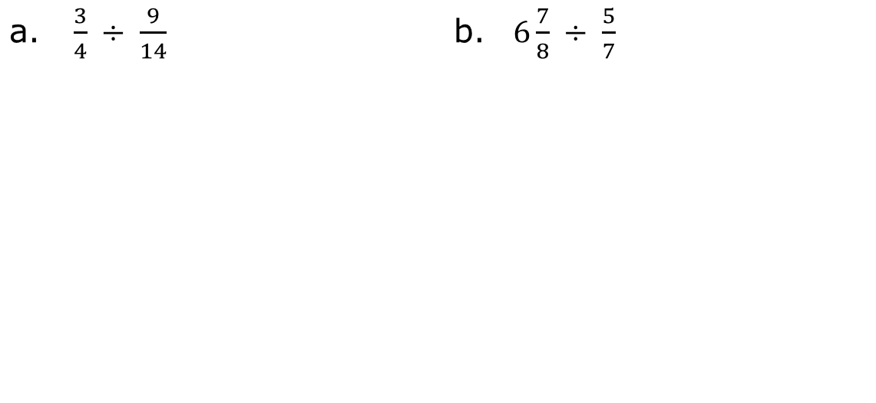
Find each quotient using your preferred method. Simplify when possible.
a. $\frac{3}{4} ÷ \frac{9}{14}$ b. | $6\frac{7}{8} ÷ \frac{5}{7}$
volume 1, pg. 85

Slide 18

Your Turn
volume 1, pg. 85

Slide 19
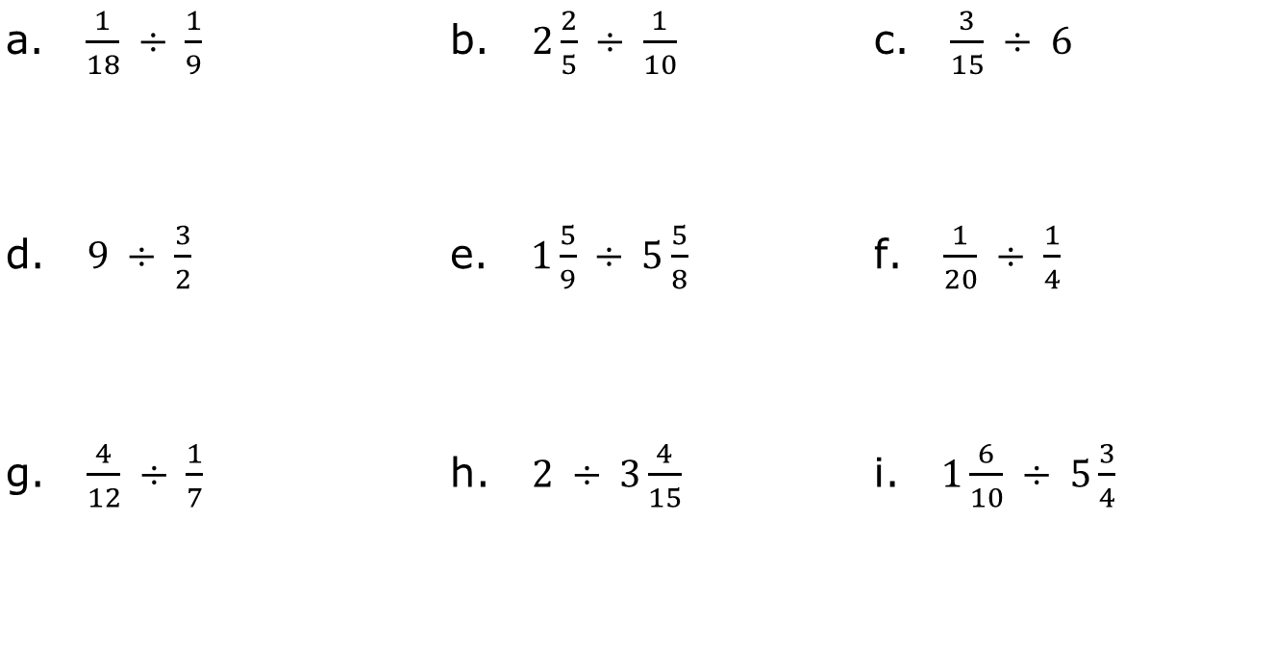
2.8.4 Your Turn!
Find each quotient. Simplify when possible.
a. $\frac{1}{18} ÷ \frac{1}{9}$ | b. $2\frac{2}{5} ÷ \frac{1}{10}$ | c. $\frac{3}{15} ÷ 6$
d. $9 ÷ \frac{3}{2}$ | e. $1\frac{5}{9} ÷ 5\frac{5}{8}$ | f. $\frac{1}{20} ÷ \frac{1}{4}$
g. $\frac{4}{12} ÷ \frac{1}{7}$ | h. $2 ÷ 3\frac{4}{15}$ | i. $1\frac{6}{10} ÷ 5\frac{3}{4}$
volume 1, pg. 85

Slide 20

Wrap-Up
volume 1, pg. 86

Slide 21
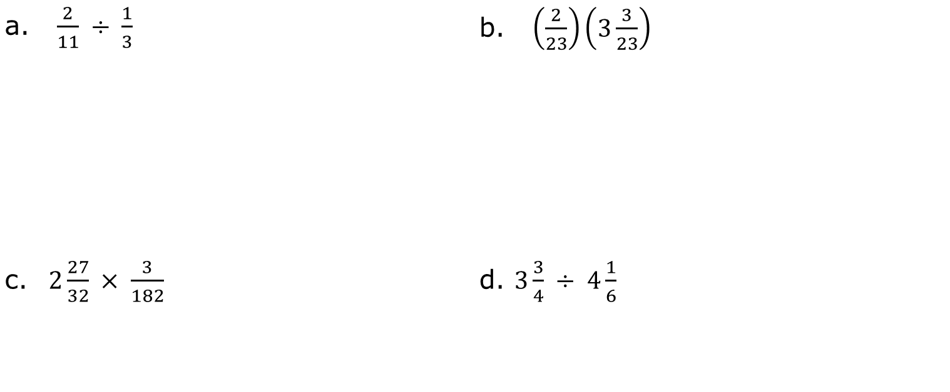
2.8.5 Wrap-Up: Ticket Out the Door
Find each product or quotient. Simplify when possible.
a. $\frac{2}{11} ÷ \frac{1}{3}$ | b. $\left(\frac{2}{23}\right)\left(3\frac{3}{23}\right)$
c. $2\frac{27}{32} × \frac{3}{182}$ | d. $3\frac{3}{4} ÷ 4\frac{1}{6}$
volume 1, pg. 86

